Slide 1
RKE Under the Hood Kubernetes Master Class Series
#Rancherk8s
December 10, 2019

Slide 2



Hussein Galal
Software Engineer
Rancher
Sebastiaan van Steenis
Engineer
Rancher
Matthew Scheer
Marketing Manager
Rancher
matthew@rancher.com

Slide 3
Rancher Master Class Series:
Trying to keep this to 40-45 minutes
Questions are always welcome
Use the questions tab to write your questions
We may respond to all, so mark your question as private if needed.
#Rancherk8s

Slide 4
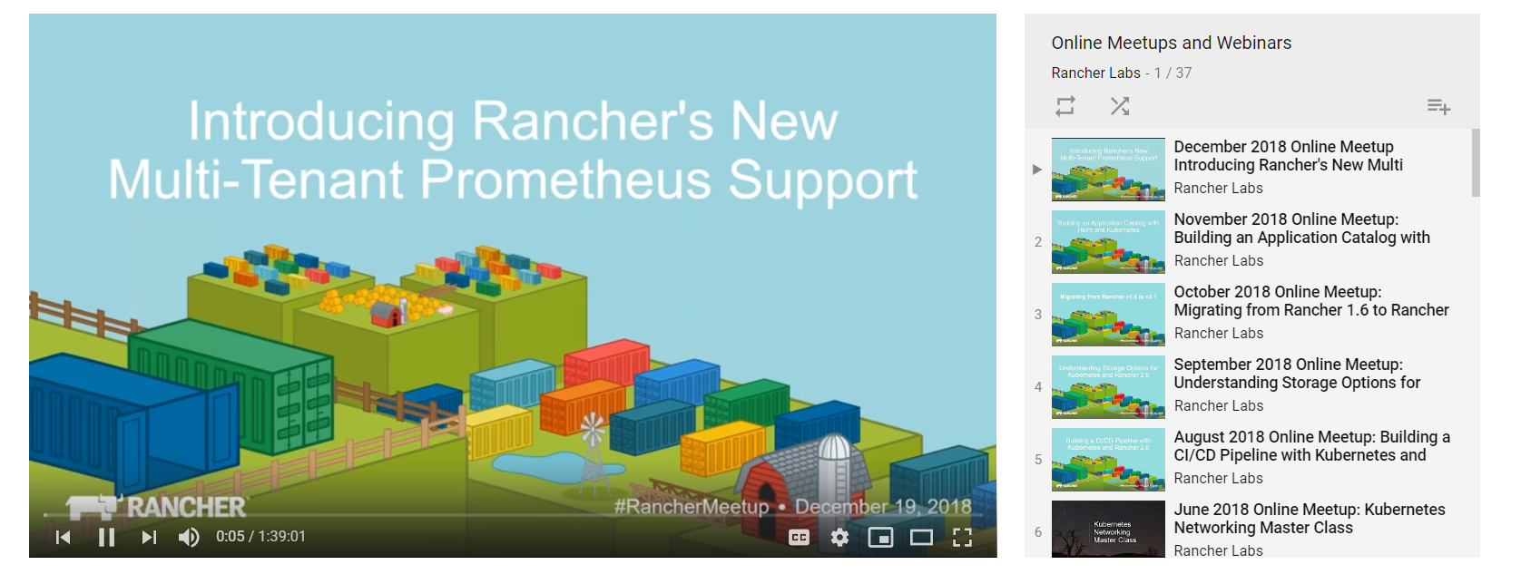
This session is being recorded!
http://youtube.com/c/rancher
#Rancherk8s

Slide 5
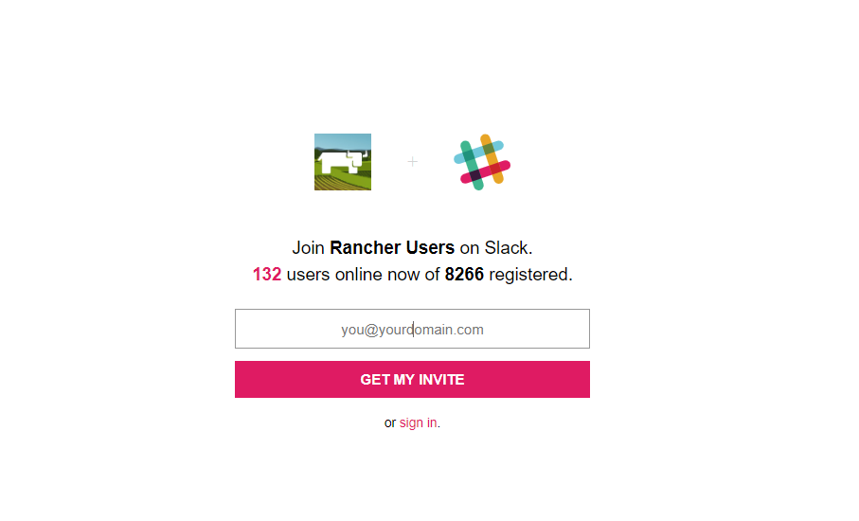
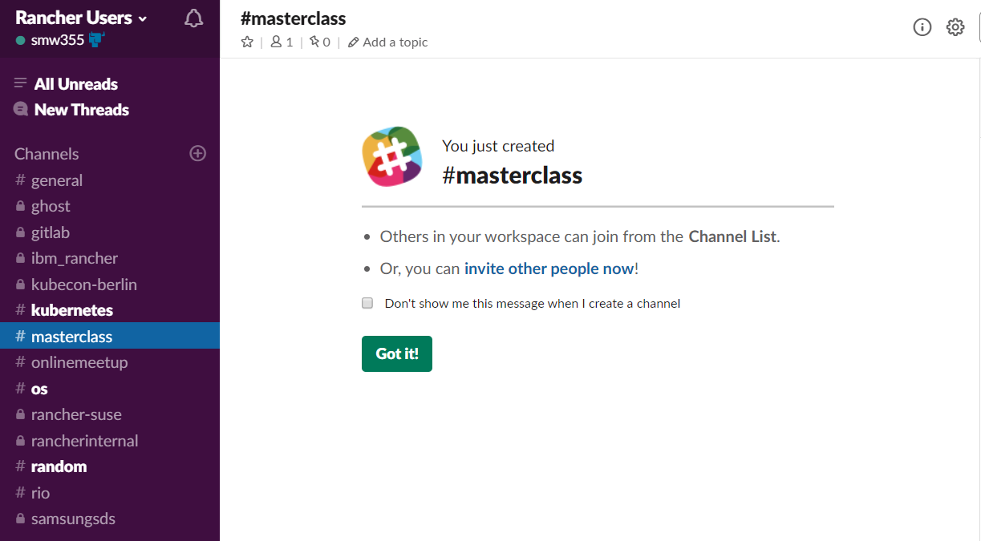
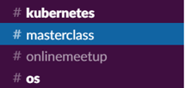
Join the conversation on Slack
http://slack.rancher.io
#masterclass
#RancherK8s

Slide 6
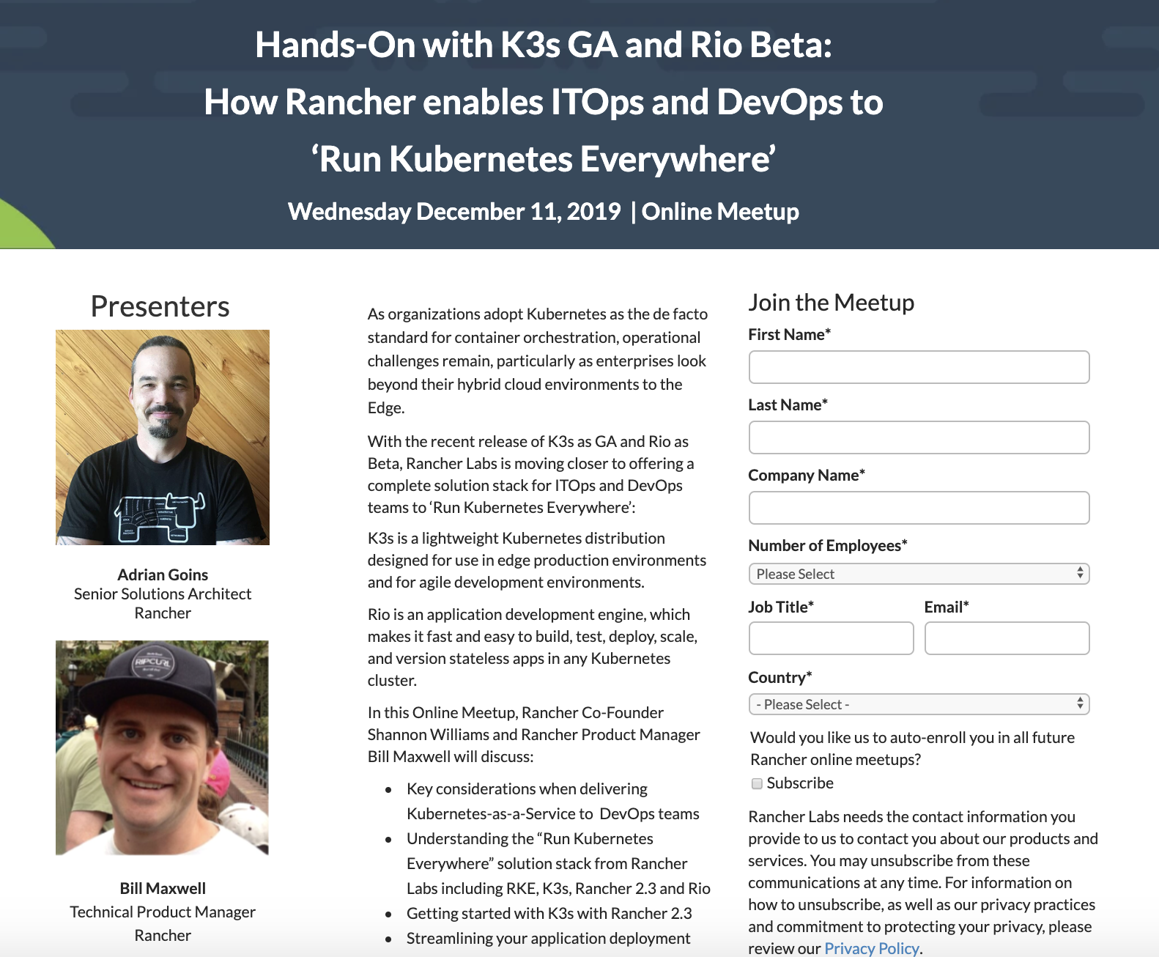
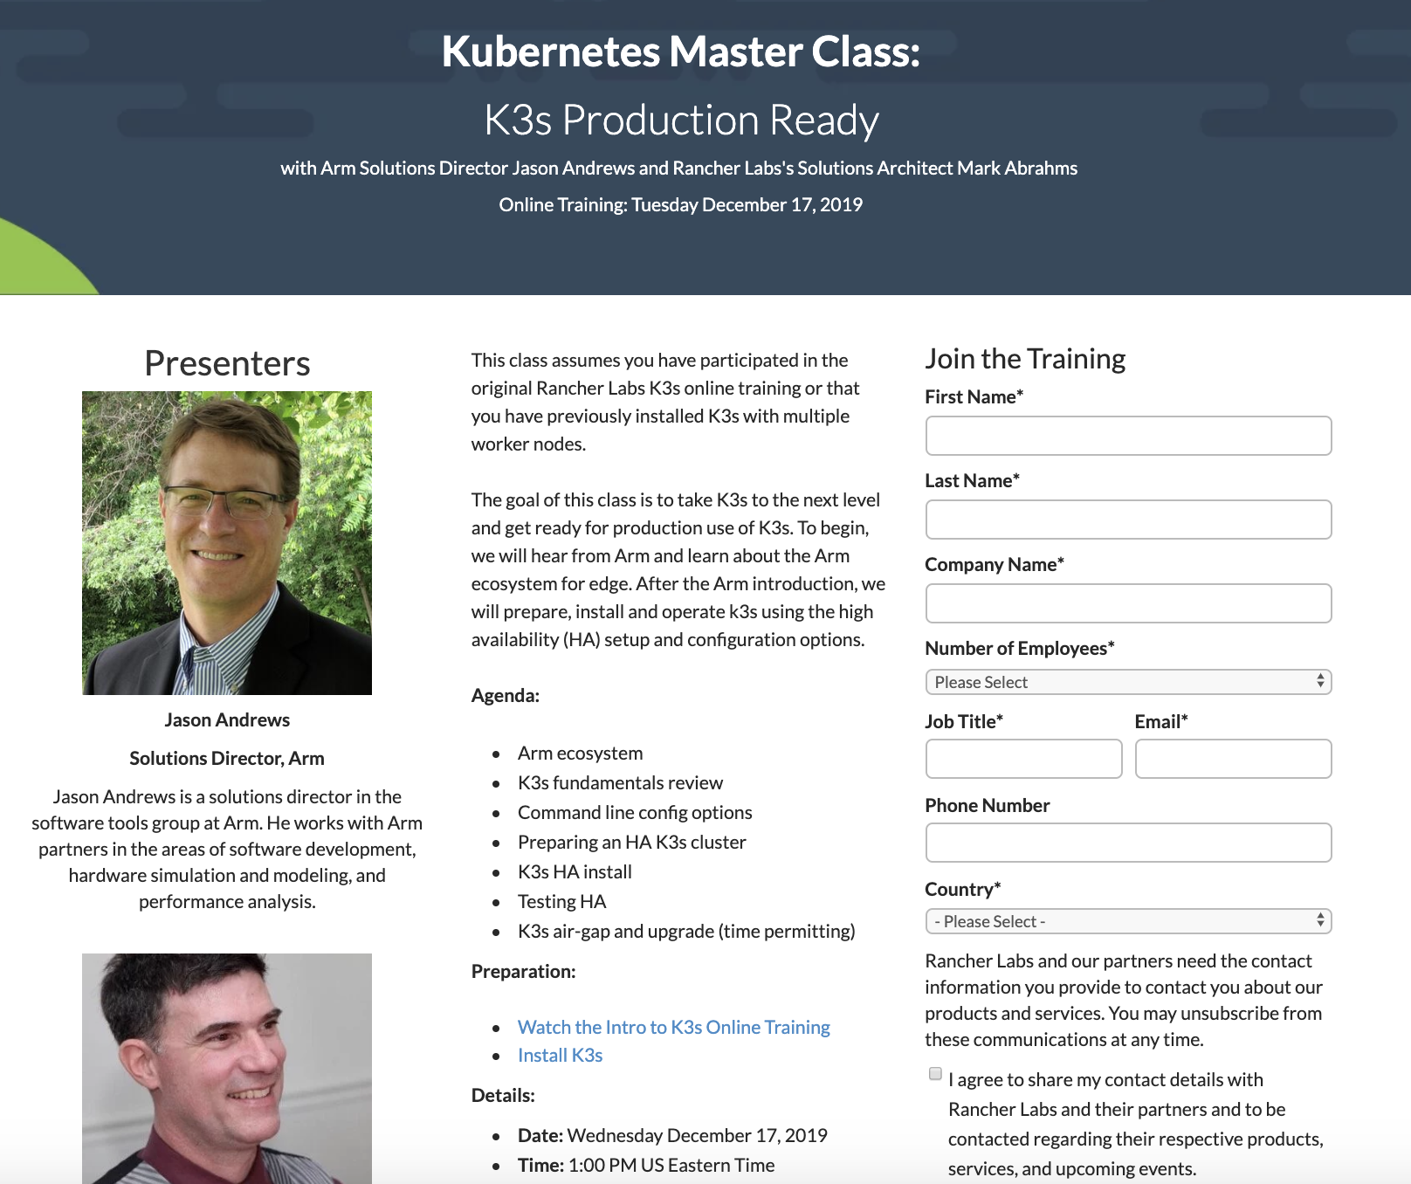
Upcoming Classes
http://rancher.com/kubernetes-master-class/
#RancherK8s

Slide 7
RKE Under The Hood

Slide 8
This session will cover :
RKE Intro
RKE Design
RKE Provisioning Workflow
RKE Reconciliation loop (ADD/REMOVE cycle)
Rancher and RKE

Slide 9
RKE Introduction
Rancher Kubernetes Engine (RKE) is a CNCF-certified Kubernetes distribution that runs entirely within Docker containers. It works on bare-metal and virtualized servers.
Requirements:
SSH Connection.
Docker Installed.

Slide 10
RKE Introduction
RKE uses cluster.yml config file to define the kubernetes cluster.
Each cluster.yml represents a kubernetes cluster configuration.
rke up uses the cluster.yml to get the nodes information and it installs the cluster according to the specs defined in the file.
Cluster.yml
---
nodes:
address: 10.0.0.1
role: [controlplane,etcd,worker]
user: ubuntu
hostname_override: node1
$ rke up --config cluster.yml
DEMO!!

Slide 11
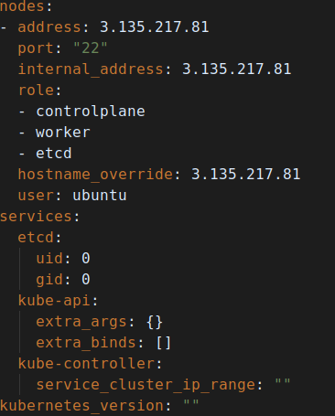
RKE Design - RkeConfig
The first building block of RKE is the configuration file definition which by default is called cluster.yml
RKE config can be generated using (rke config) command
kubelet
Node1
kube-proxy
Node2
kube-scheduler
kube-controller
NodeN
kube-apiserver
etcd v3

Slide 12
RKE Design - State File (cluster.rkestate)
RKE uses a config file (cluster.yml) to provision cluster, and keeps track of cluster status using a state file (cluster.rkestate)
State File consists of two sections:
DesiredState
CurrentState
Desired state represents the state the cluster should be in
Current state represents the actual state of the cluster
Both current and desired state consists of:
RKEConfig
Cluster Certificate bundle
Desiredstate is populated by rke from cluster.yml file during the provisioning workflow
On each run RKE tries to bring the cluster to match the DesiredState and then when it succeed it writes the CurrentState.

Slide 13
RKE Design - State File
cluster.rkestate
1
User edit cluster.yml: add new node
{
"desiredState": {
"rkeConfig": {},
"certificatesBundle": {}
},
"currentState": {
"rkeConfig": {},
"certificatesBundle": {}
}
}
2
rke init will update desired state with the new node info
3
rke up will add the new node
4
When finished it will update the current state

Slide 14
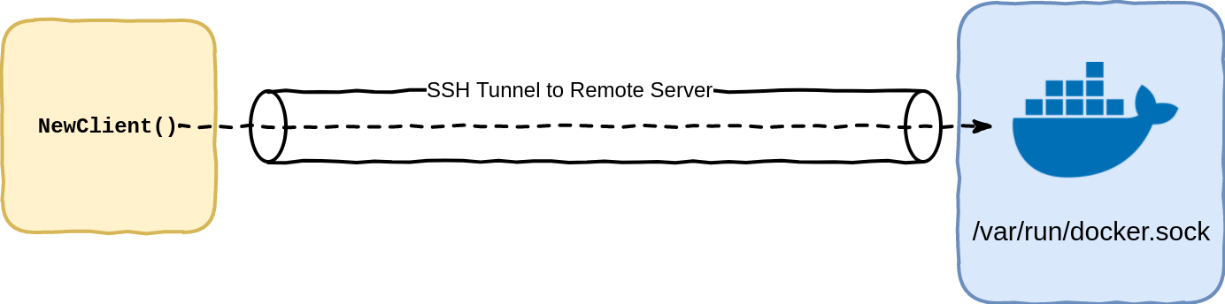
RKE Design - Nodes and Tunneling
- address: 3.135.217.81
port: "22"
internal_address: 10.0.0.1
role:
- controlplane
- worker
- etcd
hostname_override: node1
user: ubuntu
Each node should have:
Docker
SSH enabled
Each node config should have at least the following:
Address
SSH User
Role
RKE uses SSH tunneling to connect to the docker socket on each node over an ssh connection

Slide 15
RKE Design - Nodes and Tunneling cont.
Different modes of rke depends of the kind of tunneling factories.
RKE modes are:
RKE cli
Docker tunnel / ssh --> docker.sock
RKE local
Docker tunnel / --> docker service port
RKE dind
Docker tunnel / --> docker service port

Slide 16
RKE Design - Services
RKE deploys k8s components as docker containers
Components are deployed according to the node’s role:
Etcd
etcd container
kube-proxy container
kubelet container
Nginx-proxy container
Controlplane
kube-apiserver container
kube-controller-manager container
kube-scheduler container
kube-proxy container
kubelet container
Worker
kube-proxy container
kubelet container
Nginx-proxy container
Helper services:
Sidekick container (rke-tools)
Port check container (rke-tools)
Etcd recurring snapshot (rke-tools)
Certificate installer (rke-tools)
File deployer (rke-tools)
Addon Deployer (rke-tools)
/entrypoint.sh
Kubelet
Sidekick

Slide 17
RKE Design - Version
Each RKE version comes with supported kubernetes versions:
$ rke config -l -a
v1.15.5-rancher1-2
v1.13.12-rancher2-1
v1.16.2-rancher1-1
V1.14.8-rancher1-1
Version mapping is defined in kontainer-driver-metadata repo
System images
rancher/coreos-etcd:v3.3.10-rancher1
rancher/rke-tools:v0.1.50
rancher/hyperkube:v1.15.5-rancher1
K8s versions
Rke versions
weaveworks/weave-kube:2.5.2
v1.13.12-rancher1-1
v0.3.0
v1.15.5-rancher1-2
weaveworks/weave-npc:2.5.2
v0.3.1
v1.14.8-rancher1-1
rancher/coredns-coredns:1.3.1
v0.3.2
v1.16.2-rancher1-1
rancher/nginx-ingress-controller:nginx-0.25.1-rancher1
rancher/metrics-server:v0.3.3

Slide 18
RKE Provisioning workflow
When running rke up it runs:
rke init → rke up
rke uses two main functions ClusterInit() and ClusterUp()
ClusterInit() is responsible for updating the DesiredState and write a new cluster.rkestate file.
ClusterUp() is responsible of:
Comparing DesiredState with CurrentState.
Add any new nodes added to DesiredState and remove any nodes removed from from the DesiredState
Deploy the cluster components on the nodes
$ rke up --init
cluster.yml → state.DesiredState
$ rke up
state.DesiredState → Installation on nodes → state.CurrentState

Slide 19
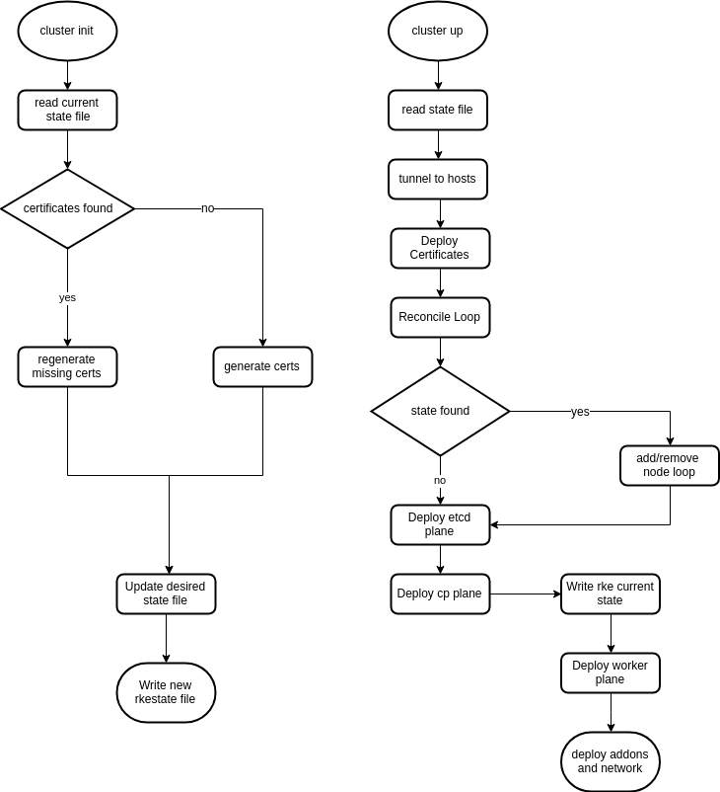

Slide 20
X509 Component Authentication
RKE components uses x509 authentication.
generating certs works as follows:
Generate master CA cert and Aggregation layer CA cert/key pair.
Generate cert/key pair for each service (kube-api, scheduler, controller, kubelet, kube-proxy)
Generate etcd cert/key pair for each etcd node.
Generate proxy-client cert/key pair.
Generate service account key file.
On each rke run, rke checks if etcd/cp node is added or removed, if yes then:
It generates etcd/kube-api cert for each new node
It regenerates old etcd/kube-api cert to update the SANs
Certificate rotation happens in rke init, it regenerates all certs.

Slide 21
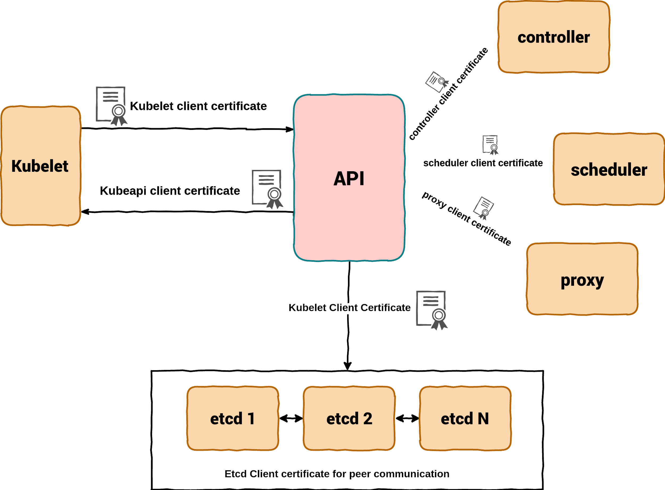
X509 Component Authentication

Slide 22
RKE Reconciliation loop
Removing a Node:
RKE check first for the ROLE:
If Etcd:
Remove etcd member from etcd cluster (etcdctl member remove)
Delete the node from k8s cluster (kubectl delete node <>)
Clean the docker containers on the host
If CP/Worker:
Delete the node from k8s cluster (kubectl delete node <>)
Clean the docker containers on the host
Adding a Node:
RKE check first for the ROLE:
If Etcd and not already a member:
Add etcd member to the cluster (etcdctl member add)
Run etcd on the new node
If CP/Worker:
Sync taints

Slide 23
RKE Reconciliation loop
RKE compares CurrentState with DesiredState
Current State
{
"desiredState": {
"rkeConfig": {
"nodes": [
{
"address": "node1",
….
}
],
Desired State
{
"desiredState": {
"rkeConfig": {
"nodes": [
{
"address": "node1",
….
},
{
"address": "node2",
….
}
],

Slide 24
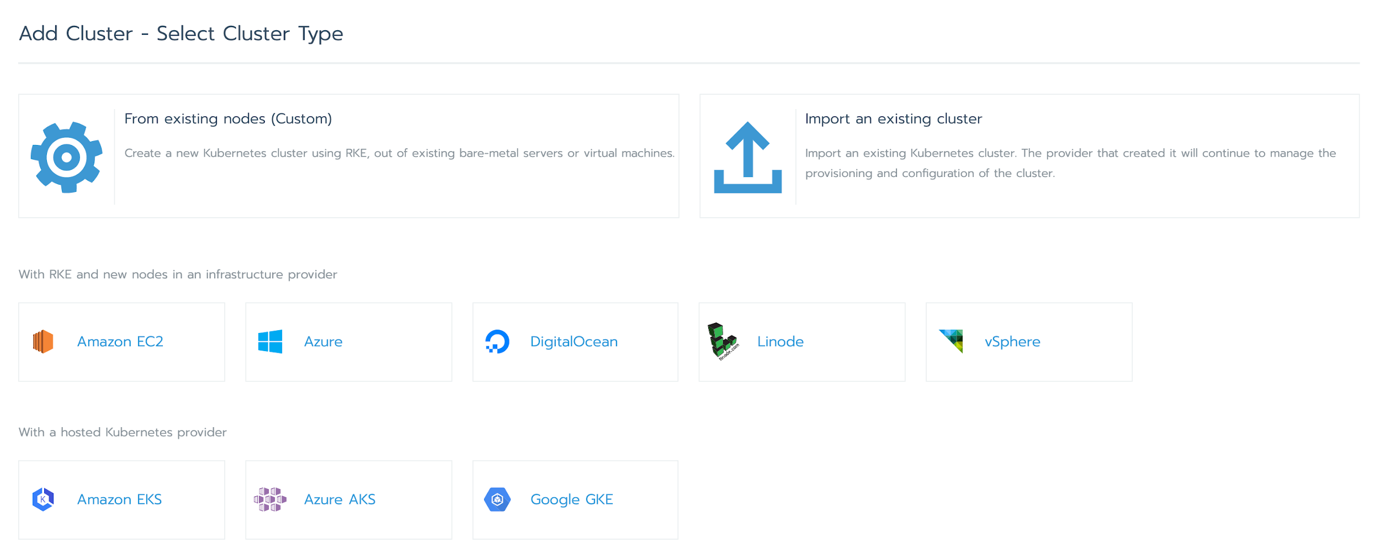
Rancher and RKE
Rancher is software to create and manage your Kubernetes cluster(s), including UI, central authentication, logging, monitoring, service mesh and much more
Regarding clusters, Rancher supports any Kubernetes cluster which can be added to Rancher in different ways:
Import existing cluster by launching needed resources to manage the cluster (Rancher agents)
Create a hosted Kubernetes cluster (for example, GKE (Google), AKS (Azure), EKS (AWS))
Create a custom cluster (uses parts of RKE, but there are differences)

Slide 25
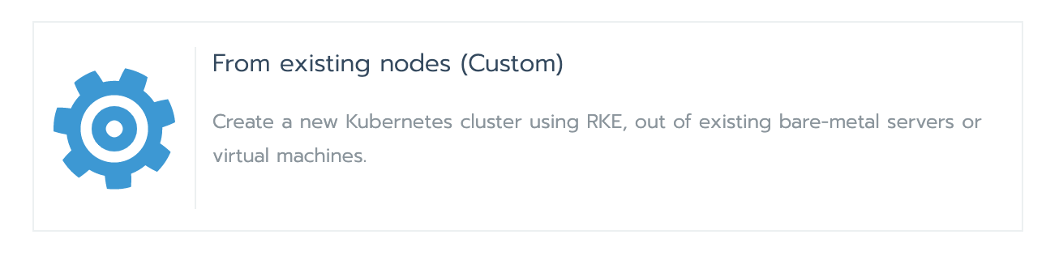
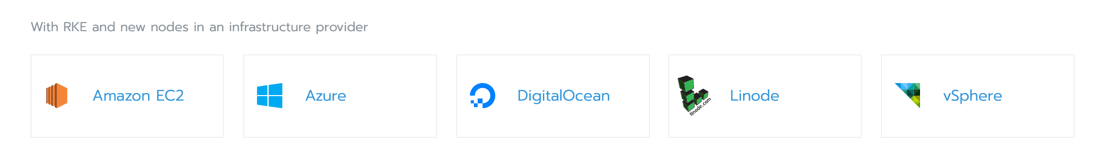
Rancher and RKE
Rancher uses parts of RKE to provision and manage the following clusters:

Slide 26
Rancher and RKE
Main differences when creating a custom cluster in Rancher vs creating a cluster using RKE
Custom cluster configuration is a combination of Rancher options plus RKE cluster.yml options vs just cluster.yml when using RKE
Nodes are dynamically added to the cluster via Rancher (agent) versus a static cluster.yml file when using RKE
Only nodes with etcd and/or controlplane role are part of the RKE plan when provisioning a cluster, workers are handled by Rancher separately
Cluster provisioning/reconcile is handled by Rancher vs rke up on the command line using RKE
etcd snapshots are handled by Rancher vs the etcd-rolling-snapshots-container in RKE

Slide 27
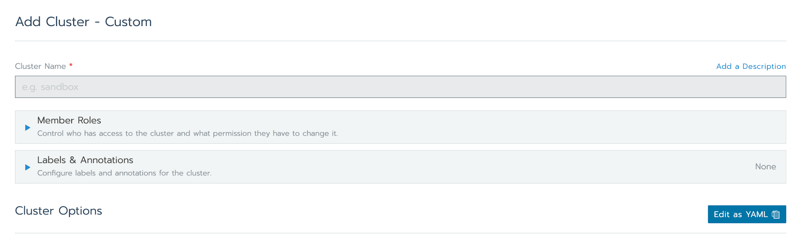
Cluster configuration in Rancher
Clusters Options show part of the RKE configurable options in the UI, can also be edited as a YAML file using Edit as YAML

Slide 28
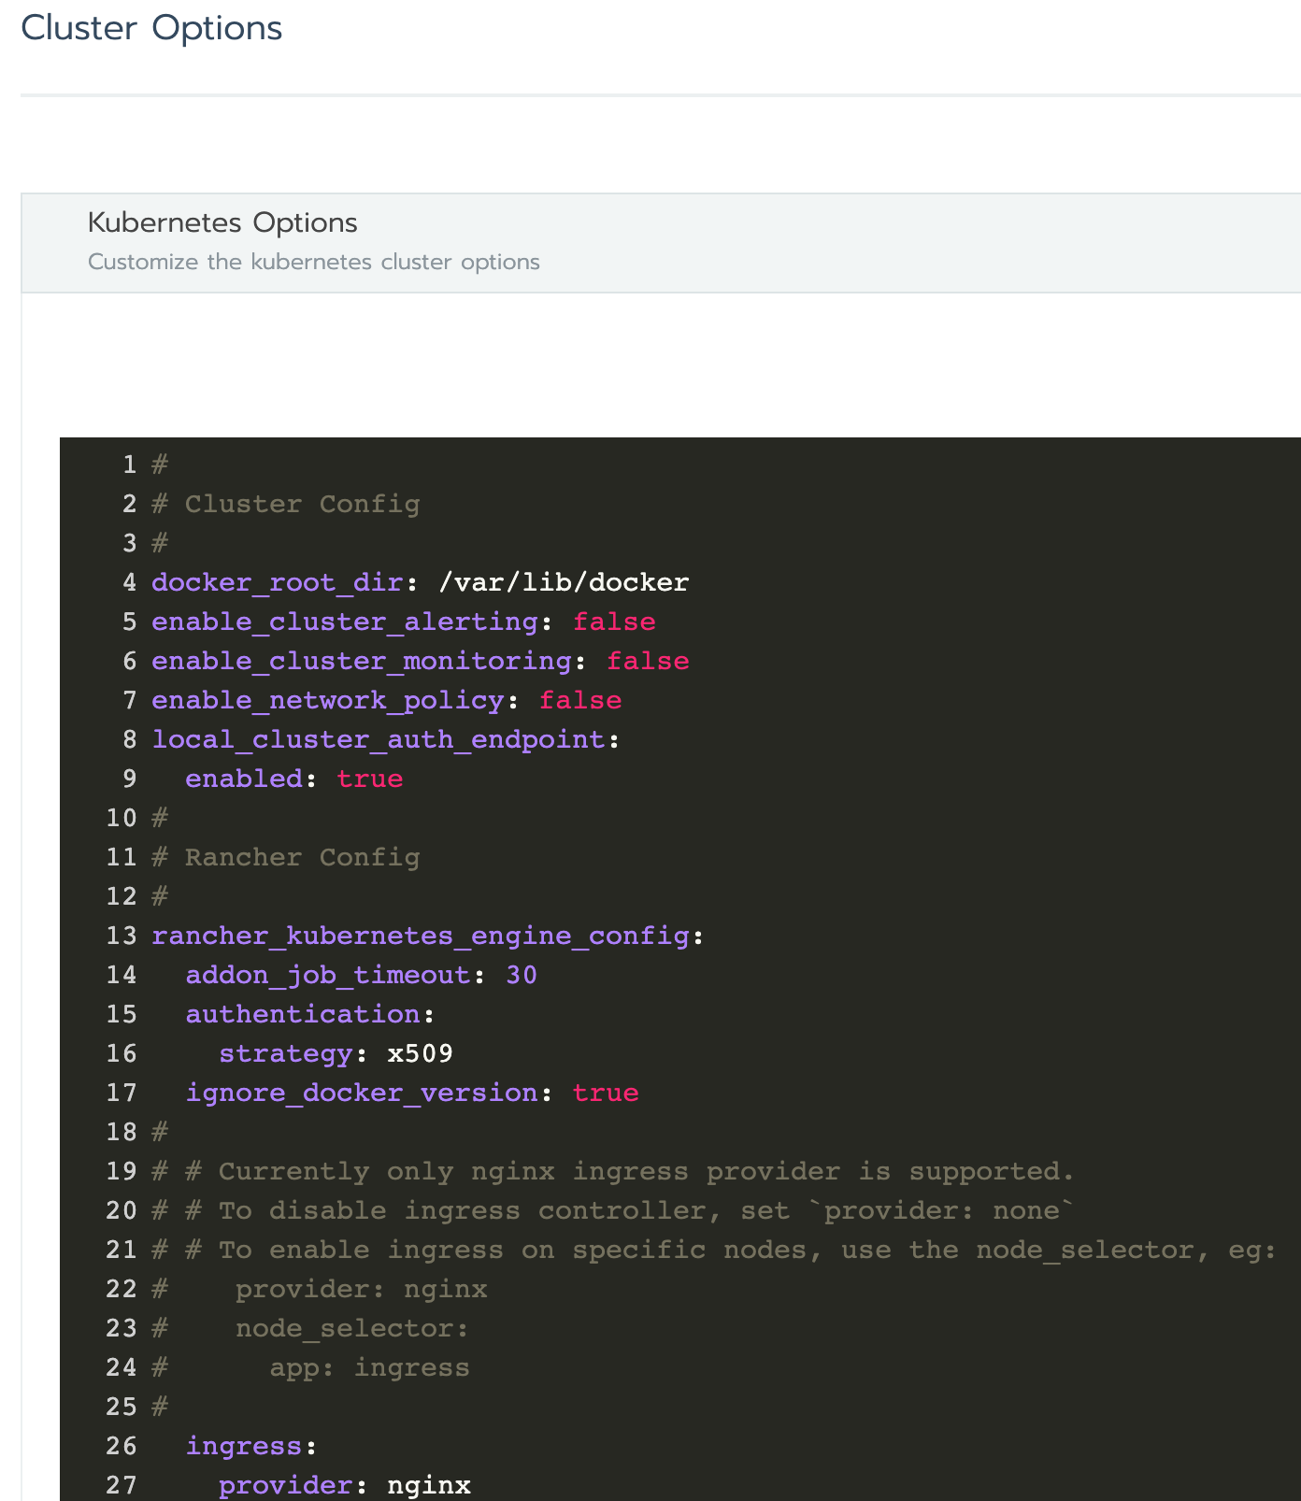
Cluster configuration
Clusters Options show part of the RKE configurable options in the UI, translates to the `rancher_kubernetes_engine_config` key when Edit as YAML is used
Find all options in the documentation: https://rancher.com/docs/rke/latest/en/config-options/

Slide 29
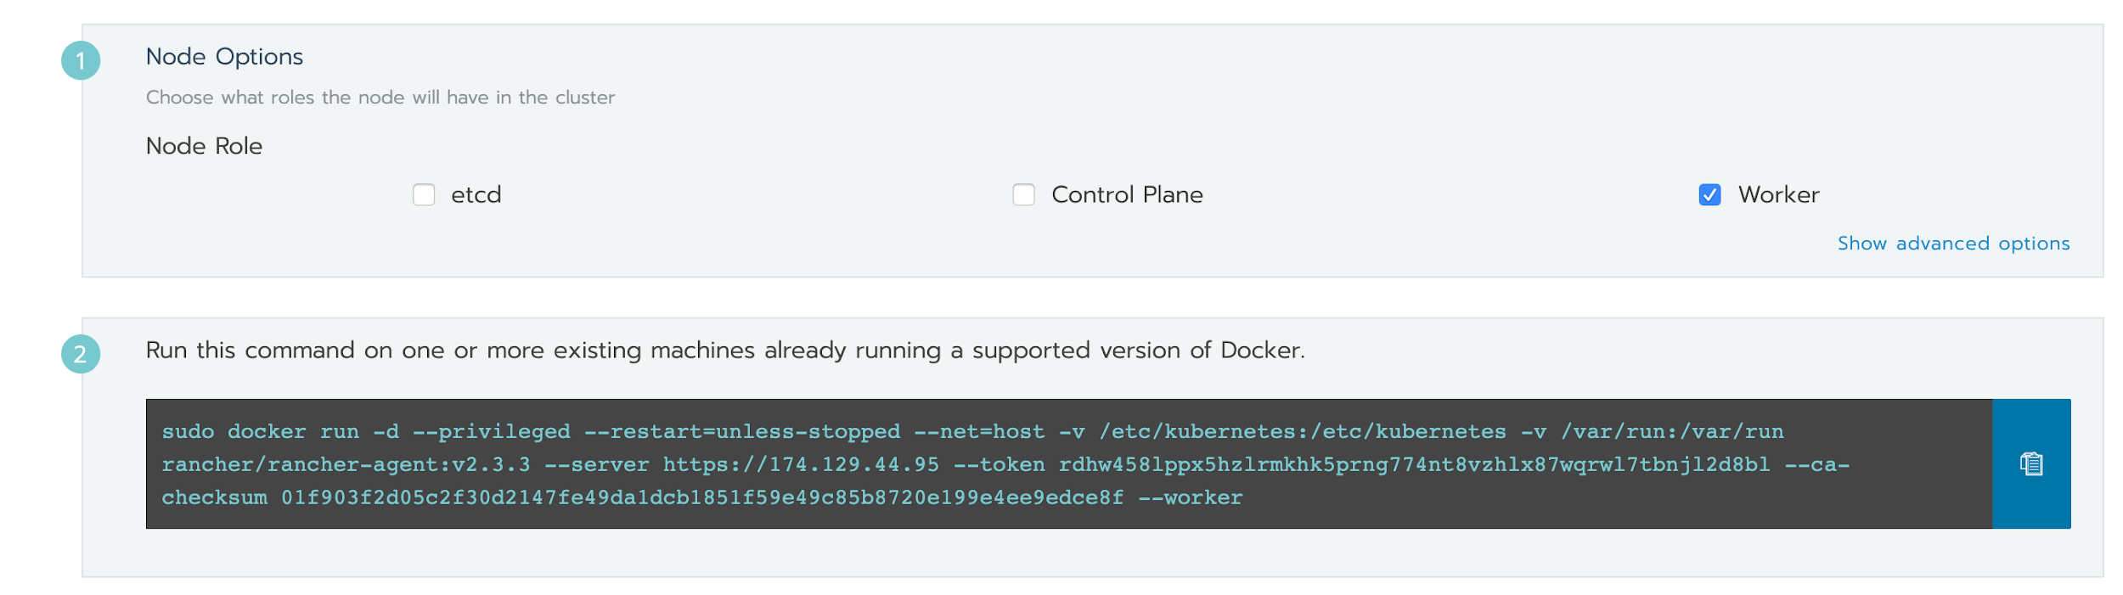
Adding a node to a custom cluster
See all options under advanced options or in the documentation: https://rancher.com/docs/rancher/v2.x/en/cluster-provisioning/custom-clusters/agent-options/

Slide 30
Adding a node to a custom cluster
The Rancher agent is used to add a node to a cluster, and provide connectivity from Rancher to the node to provision/reconcile the node according to the cluster configuration
After the node is successfully registered to the cluster (after provisioning has been completed and the kubelet was started and successfully connected to the kube-apiserver), the agent container created via the docker run command is removed by the cattle-node-agent DaemonSet pods
More information about the agents is in the documentation: https://rancher.com/docs/rancher/v2.x/en/cluster-provisioning/rancher-agents/

Slide 31
Adding a node to a custom cluster
Global flow of agent:
Launch agent container
Entrypoint is a shell script which parses the flags and runs some validation tests on the flags and provided values (¹)
Runs agent binary and connects to Rancher using a WebSocket connection (²)
Validate cluster and token, create node (³)
Agent executes the plan provided by Rancher (⁴)
Rancher will run cluster provisioning/reconcile based on a new node being added
Node will be registering to the cluster and the cattle-node-agent DaemonSet pods will remove any agent container that was run via the provided Docker run command (⁵)
https://github.com/rancher/rancher/blob/v2.3.3/package/run.sh
https://github.com/rancher/rancher/blob/v2.3.3/pkg/agent/main.go#L265
https://github.com/rancher/rancher/blob/v2.3.3/pkg/tunnelserver/tunnel.go#L107
https://github.com/rancher/rancher/blob/v2.3.3/pkg/rkenodeconfigclient/client.go#L68
https://github.com/rancher/rancher/blob/v2.3.3/pkg/agent/main.go#L277

Slide 32
Rancher and worker nodes
Worker nodes are handled differently in Rancher, they are not part of the provisioning/reconcile process (The banner in Rancher indicating a cluster is in Provisioning state)
Agent requests nodeconfig, nodeconfig is generated on Rancher side, agent executes the nodeconfig (¹)
The nodeconfig consists of everything needed for the Kubernetes components to function
What Docker containers need to be running for each Kubernetes component
What configuration is needed for each Kubernetes component
Any files needed to configure each Kubernetes component (For example, cloud-config, but also certificates)
https://github.com/rancher/rancher/blob/v2.3.3/pkg/rkeworker/execute.go

Slide 33
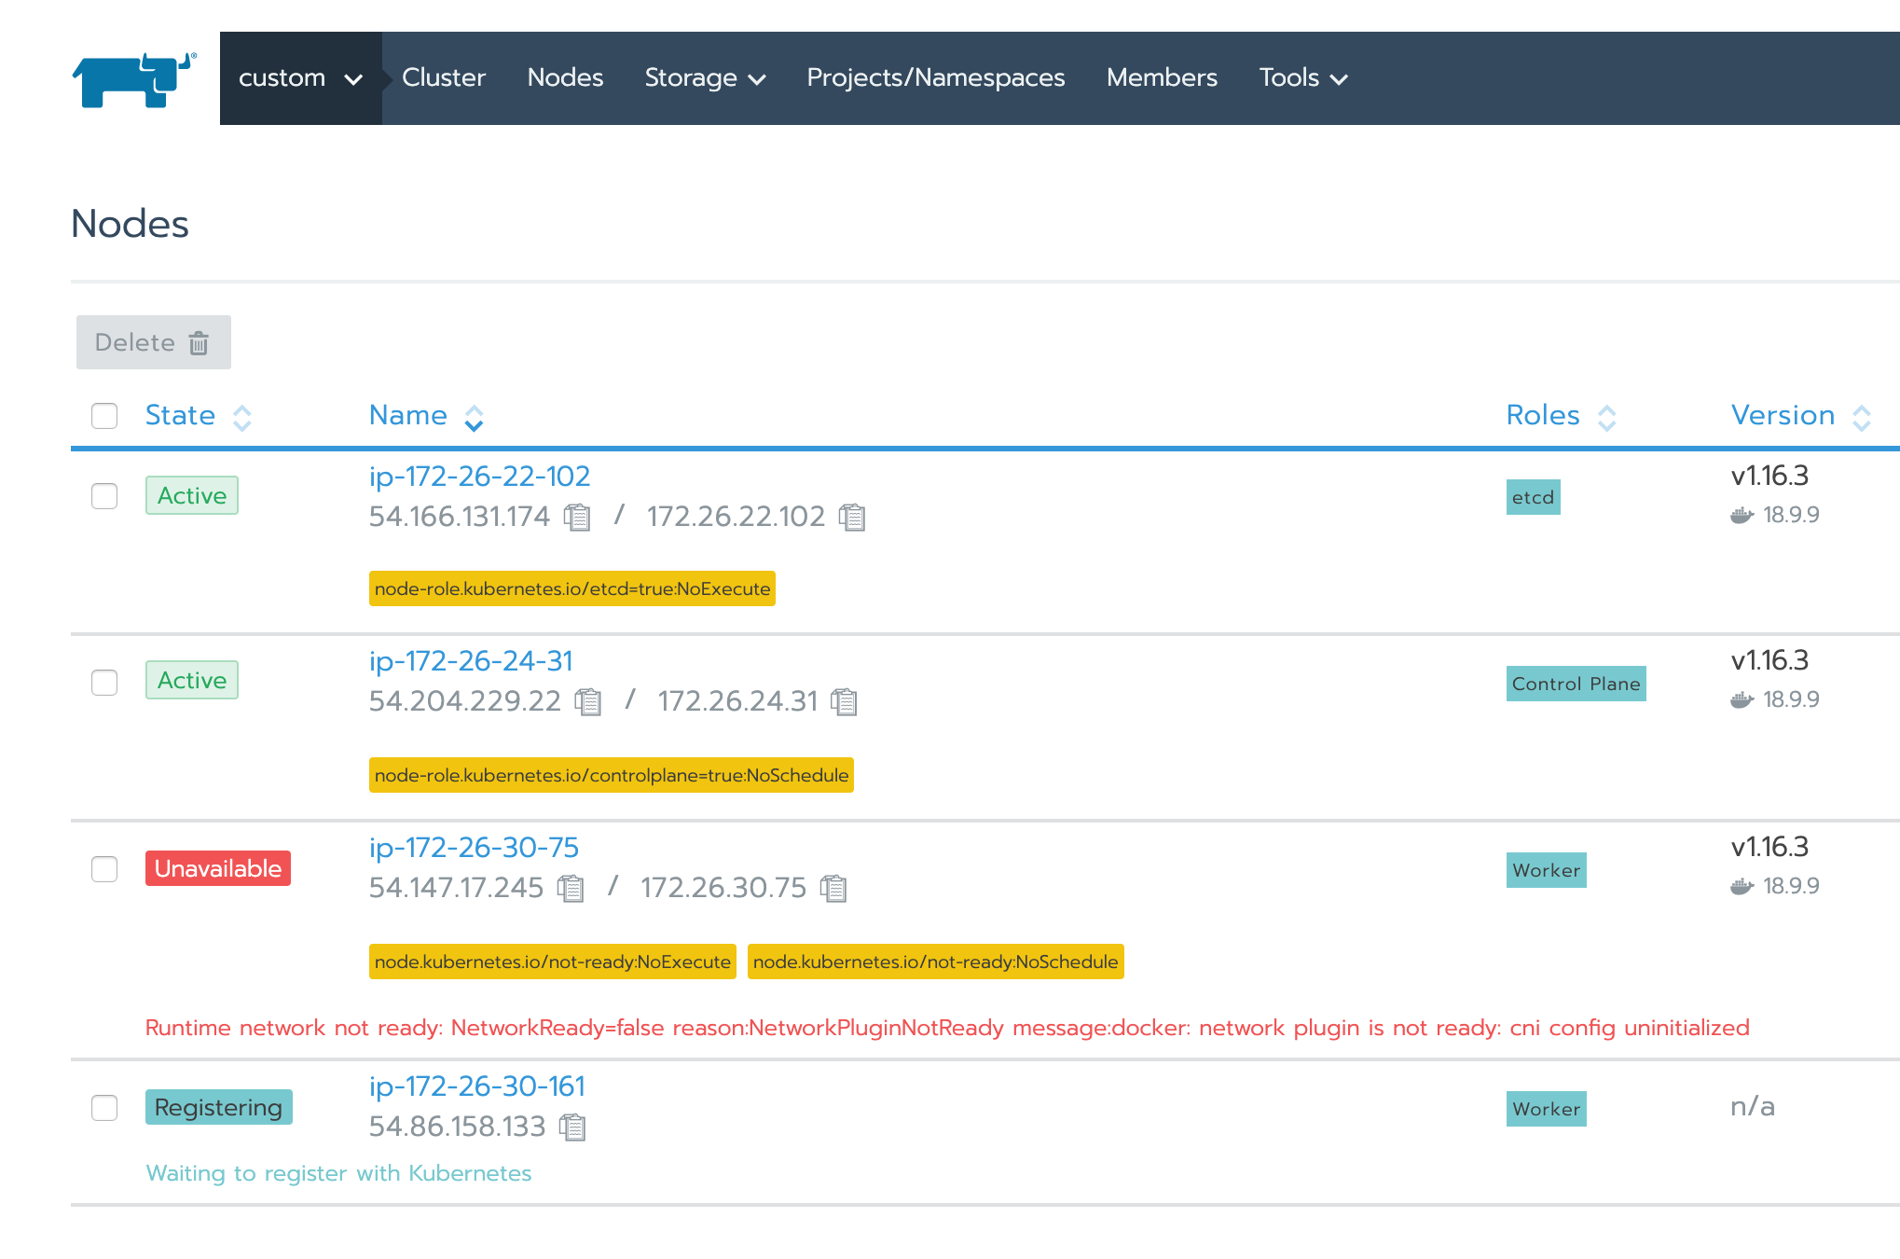
Rancher and worker nodes
Provisioning state will process nodes with the roles etcd and/or Control Plane, as cluster provisioning succeeds, the workers will execute the contents of their own retrieved nodeconfig

Slide 34
Custom cluster provisioning/reconcile
All clusters in Rancher are configured with a driver (look for the `driver` key in the View in API view for a cluster)
The term kontainerdriver refers to kontainer-engine (https://github.com/rancher/kontainer-engine), which is a command line tool and used as a library in Rancher to provision clusters
Kontainer-engine uses drivers as well, a driver contains the logic to create/update/remove clusters (¹)
See the functions Create/Update/Remove for the most common cluster actions, here you can also find the reference to the RKE functions. For instance, when an update to the cluster is called (²)
https://github.com/rancher/kontainer-engine/blob/master/drivers/rke/rke_driver.go
https://github.com/rancher/kontainer-engine/blob/release/v2.3/drivers/rke/rke_driver.go#L229

Slide 35
Custom cluster provisioning/reconcile
Rancher uses Kubernetes controllers to make sure certain actions regarding clusters can be performed
Kubernetes controllers are control loops that watch a state and act upon them (bring current state to desired state)
There are many controllers in Rancher, below are controllers mentioned that are a good starting point
The cluster provisioner controller kicks off the needed functions to provision/reconcile a cluster (¹)
The nodesyncer makes sure the node in Rancher is synced with its state in Kubernetes (amongst other functions like labels and deleting the node if its deleted on the Kubernetes side) (²)
https://github.com/rancher/rancher/blob/v2.3.3/pkg/controllers/management/clusterprovisioner/provisioner.go#L388
https://github.com/rancher/rancher/blob/v2.3.3/pkg/controllers/user/nodesyncer/nodessyncer.go#L218

Slide 36
Etcd snapshots
In RKE, etcd snapshots are handled by creating the etcd-rolling-snapshots container with the configuration as defined in cluster.yml
When provisioning a custom cluster via Rancher, this container does not exist
Rancher is responsible for creating/rotating/deleting etcd snapshots for custom clusters
This is handled by a controller, the etcdbackup-controller (¹)
https://github.com/rancher/rancher/blob/v2.3.3/pkg/controllers/management/etcdbackup/etcdbackup.go

